Slide 1

WELCOME
COHORT 5
7th Sept – 3rd Dec 2026
Suite 6-6-7, Level 6, Menara MAA

Slide 2



Languages for Building Web Application
Build a web page structure
Add stylings to web page
Add dynamic behavior/interactivity
to web page

Slide 3
Contents
Introduction to JavaScript
  Variables
  Data Types
  Data Structure
  Equality Comparisons

Slide 4
JavaScript
1995: Birth of JavaScript:
Created by Brendan Eich at Netscape Communications.
Early Purpose: Dynamic Web Pages:
Designed to enable developers to create dynamic content and manipulate the Document Object Model (DOM), enhancing user experience.
Browser Adoption and Standardization:
JavaScript quickly gained widespread adoption in web browsers.
Modern JavaScript: Beyond the Browser:
Modern browsers have integrated developer tools that allow for direct Javascript code execution within their consoles.

Slide 5
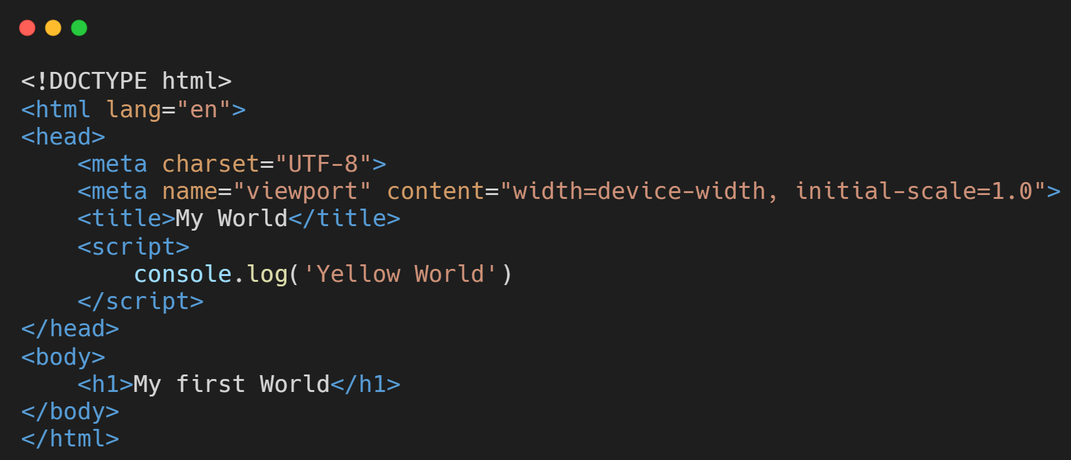
HTML & JavaScript
Create a file named “index.html” or any name you prefer

Slide 6
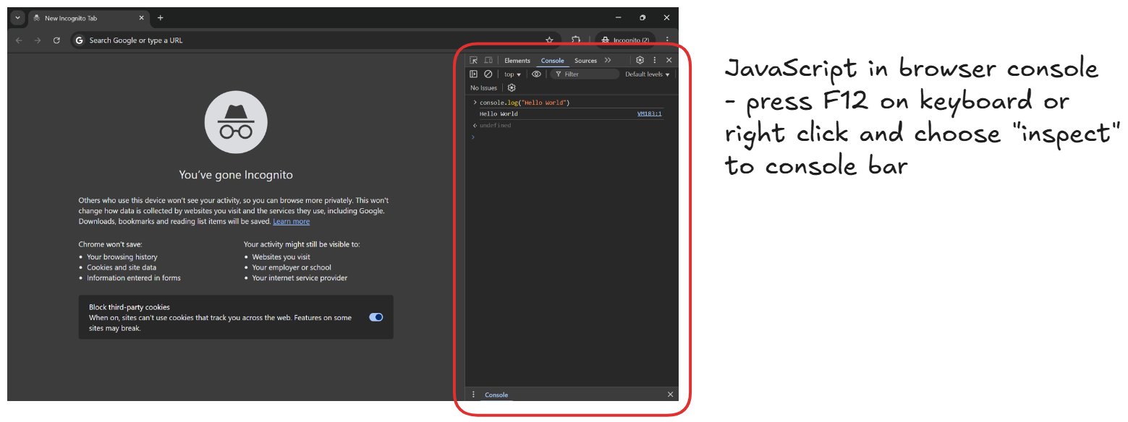
JavaScript in Browser

Slide 7
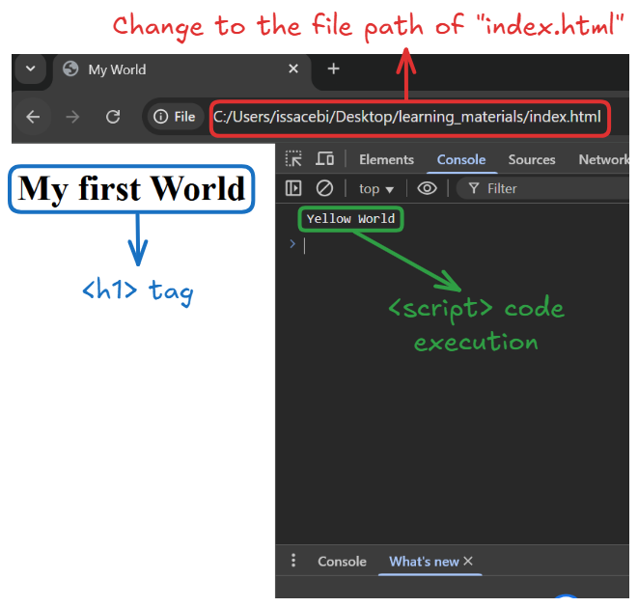
HTML & JavaScript

Slide 8
Variable
A variable is a named value in your program.
A variable is a temporary storage – it only exists while the program is running.
Variables are often used to store intermediate values of calculations in order to make a program easier to understand.

Slide 9
Variable Declaration
A JavaScript statement
A value/expression
let width = 10;
A statement should be terminated with a semicolon
The keyword “let” to indicate a variable is to be declared
A variable name
Assignment operator

Slide 10
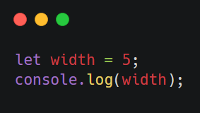
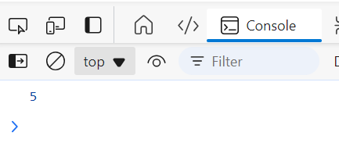
Display output to a browser console

Slide 11
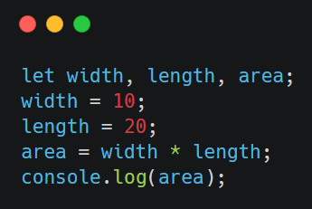
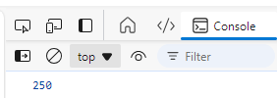
More variable declarations
Declare multiple variables in one statement

Slide 12


Recommended rules for naming a variables
Use lower case letters except for the start of each new word after the first word – lower camel case style
Or separate the words by an underscore letter
let englishscore = 76;
let mathScore;
let physicScore;
Hard to read
let ChemistryScore = 57;
First letter should start with lowercase
let biology_score;
let history-score;
Variable names cannot be separated by a dash

Slide 13
Recommended rules for naming a variables
Use meaningful names
let mathScore;
let physicScore;
let score1;
let score2;

Slide 14
Recommended rules for naming a variables
The usage of JavaScript keyword is strictly not allowed as it will incur syntax error.
let function = “addition”;
let new = 1;
let case = 3;
https://www.w3schools.com/js/js_reserved.asp
Refer to this source for more info about JavaScript reserved keyword

Slide 15
Data types available in JavaScripts
Boolean (only two possible values: true or false)
Null (only 1 possible value: null)
Undefined (only 1 possible value: undefined)
Number
String
Array
Object
Notes:
typeof NaN; // number
typeof -Infinity; // number

Slide 16
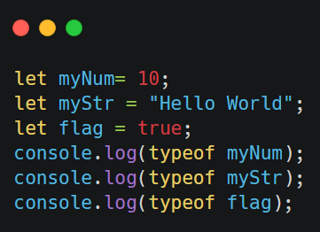
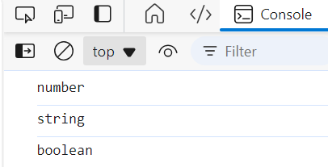
Checking data type using “typeof” operator

Slide 17
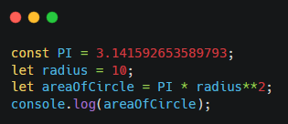

Constant Value
In JavaScript, we can use const keyword to declare a variable that cannot be reassigned a new value.
A constant value

Slide 18
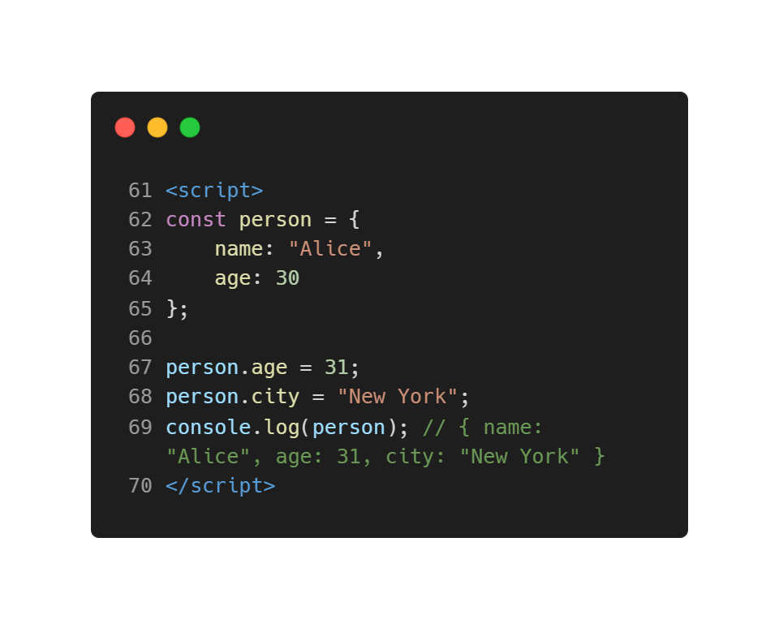
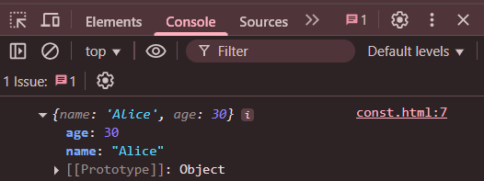
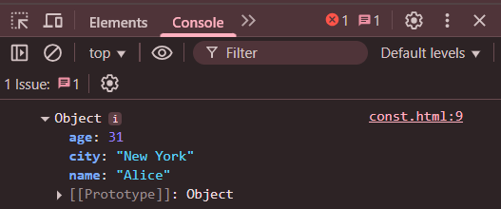
Constant Value
In JavaScript, declared object (const) itself cannot be reassigned, but properties can be modified.
Before reassign
A constant value
After reassign

Slide 19
Data Structures - Array
JavaScript arrays are used to store multiple values under a single name.
They come with built-in functions to perform common operations on these values.

Slide 20
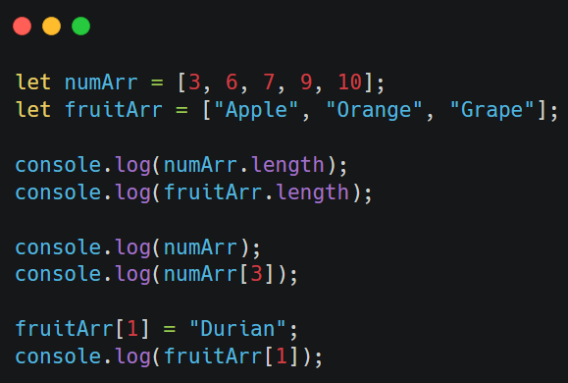
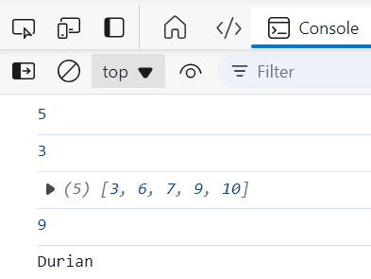
Data Structures - Array
Return number of elements in array
Array elements
Use index to access array element

Slide 21
Data Structures - JavaScript Object
A JavaScript object is a collection of key-value pairs.
Key/Property: A string or symbol used to identify a property.
Value: Can be any data type, including numbers, strings, booleans, arrays, other objects, or functions.

Slide 22
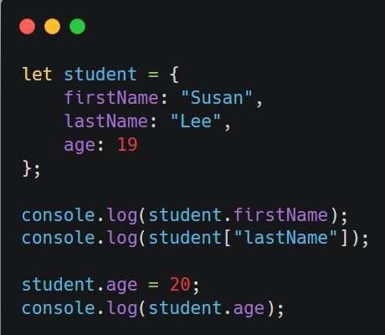
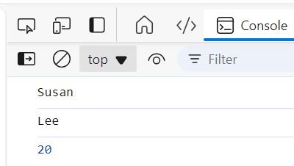
Create a JavaScript object
Keys
Values

Slide 23
Equality Comparison
JavaScript Equality: === vs. ==
  Strict Equality (===): Compares value and type.
  Loose Equality (==): Compares value after type conversion.

Slide 24
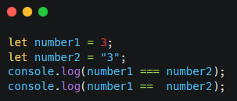
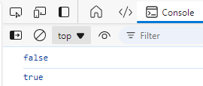
Difference between “===” and “==”
Strict equality comparison –
if the values are of different data types,
the values are considered unequal
You shall try to use strict comparison operators “===” and “!==” in your JavaScript program to keep a good coding style
Abstract equality comparison –
Compare two values for equality,
after converting both values to a common type

Slide 25
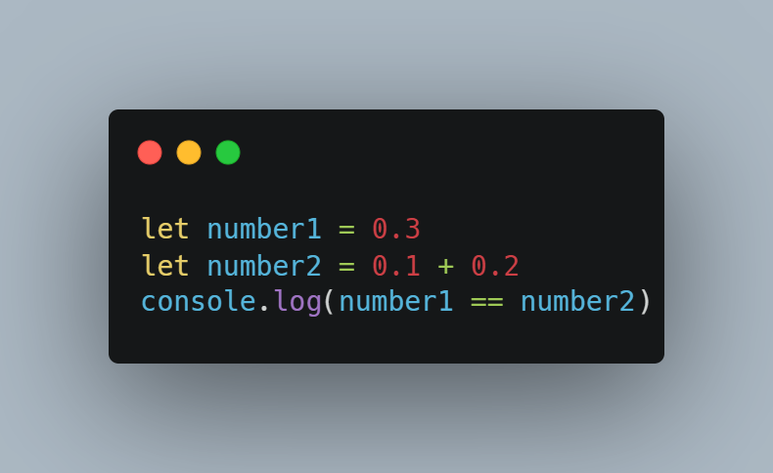
Equality Comparison

Slide 26
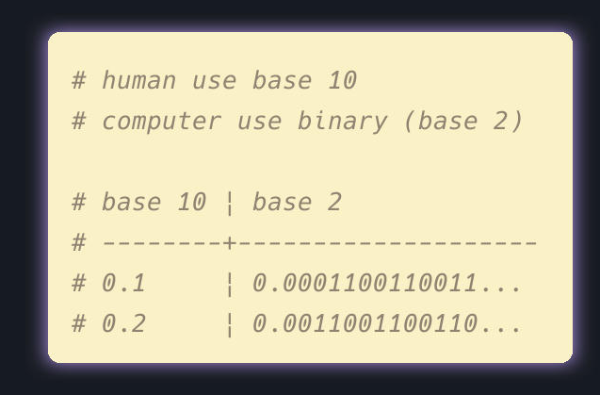
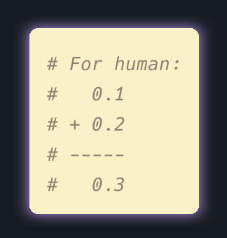
Equality Comparison

Slide 27
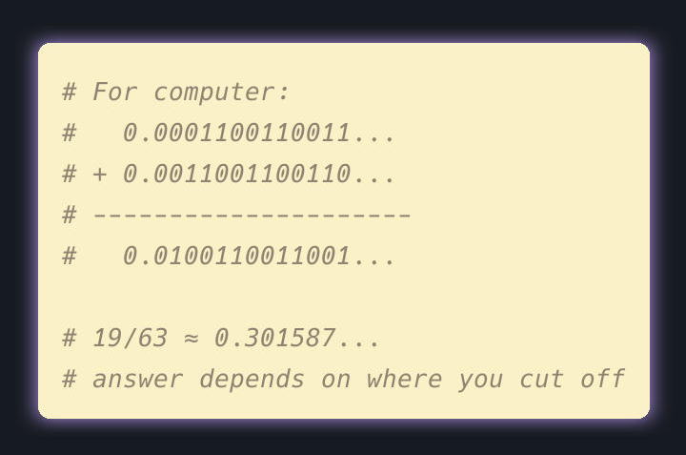
Equality Comparison
Reference: https://www.youtube.com/watch?v=PZRI1IfStY0&pp=ygUcY29tcHV0ZXJwaGlsZSBmbG9hdGluZyBwb2ludA%3D%3D
https://builtin.com/articles/0-1-0-2

Slide 28
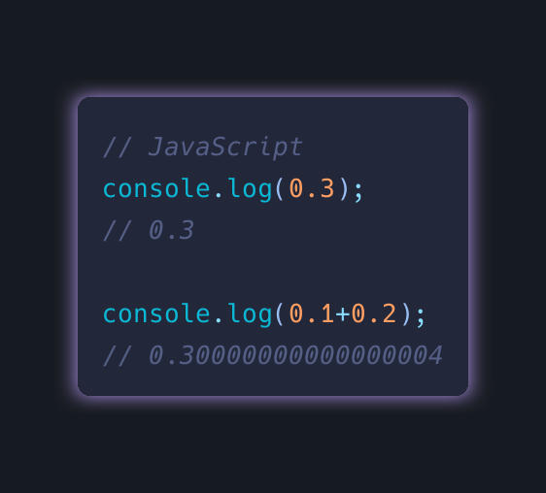
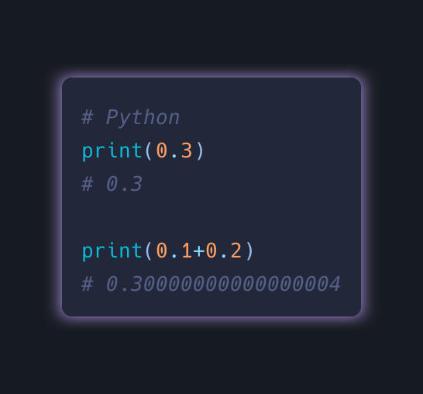
Equality Comparison

Slide 29
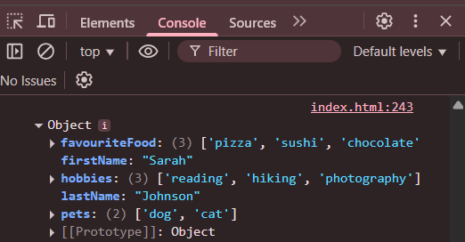
Coding Exercise 1.3
Scenario - You are building a simple application to manage team member information (there are 5 members in your team).
Each team member should have the following properties:
First name: The team member's first name.
Last name: The team member's last name.
Hobbies (array): An array of the team member's hobbies.
Favourite food (array): An array of the team member's favorite foods.
Pets (array): An array of the team member's pets.
Example

